Slide 1


Secure Data Transfer
Ismael Flores Pérez

Slide 2
What are we going to use
Python
AES algorithm. More information here http://aesencryption.net/
Pycrypto lib. More information here https://pypi.python.org/pypi/pycrypto

Slide 3
How can we detect if we use a secure communication
Using Wireshark listening communications and message exchange. More information here https://www.wireshark.org/
Detecting if all messages have a correct structure.

Slide 4


How do we use this secure communication
Secure message exchange between our MV and RaspBerry Pi.
Encrypts
Decrypts

Slide 5
Modifications
RaspBerry pi doesn't insert data directly values on the database. Before this modification it did it directly.
MV has to insert all information on the data base.

Slide 6
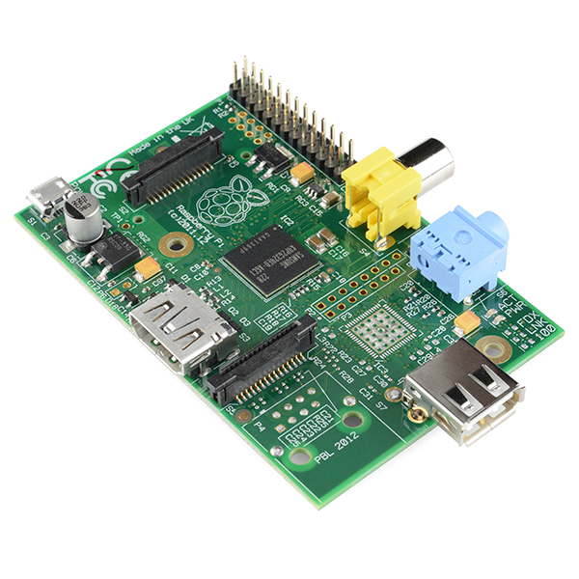
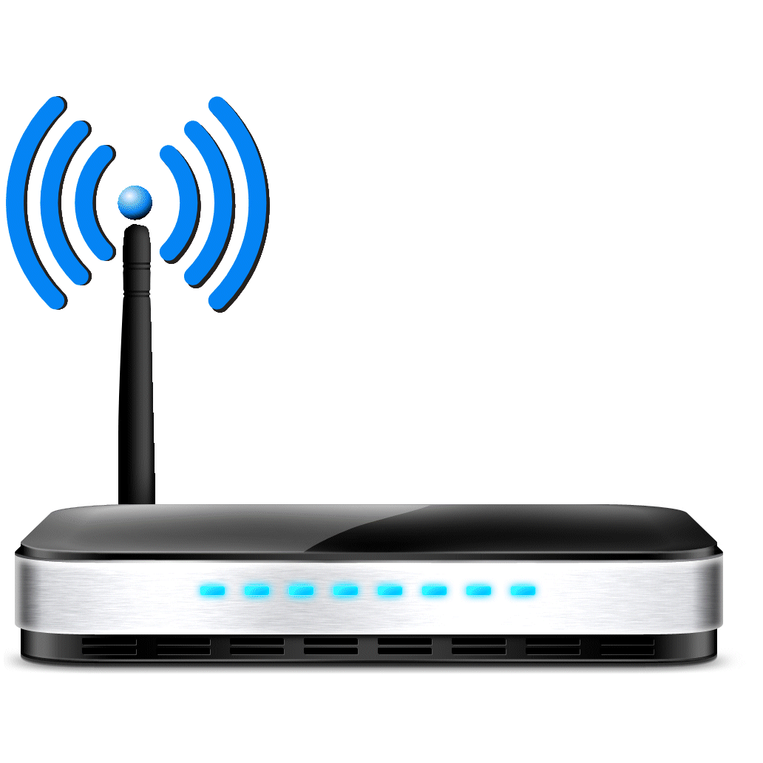
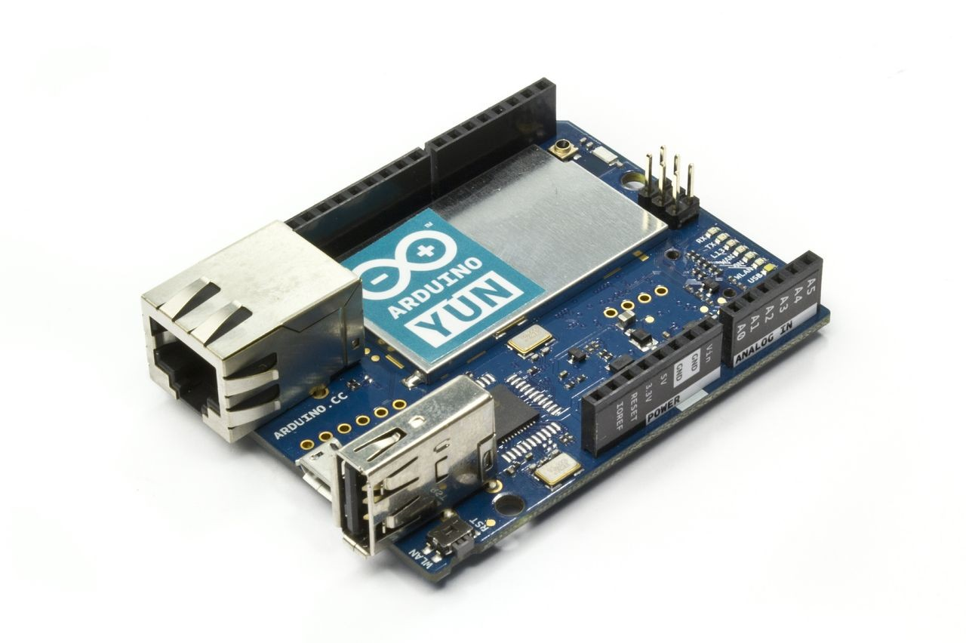
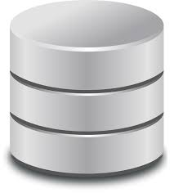
Network's structure
2 DONGLES
PUT

Slide 7
Conclusions
Secure access to our database.
Secure communications between Raspberry Pi and our MV.
We've got put operations using python in our database, using efficient communications.

Slide 8
References
http://aesencryption.net/
https://www.raspberrypi.org/forums/viewtopic.php?f=36&t=15130
https://pypi.python.org/pypi/pycrypto
https://www.wireshark.org/

